Slide 1




Be a part of the Smokefree generation

Slide 2
What percentage of Sheffield smokes?

Slide 3
Only 13.3% of people in Sheffield smoke

Slide 4
What are the potential health effects from smoking?
The younger the age of uptake of smoking, the greater the harm is likely to be.
Early uptake is associated with:
Heavier smoking
Higher dependency
Lower chance of quitting
Higher number of deaths later in life
Notes:
Have young people think about potential health effects which could be caused by smoking-
Some examples- Cancer, can cause blindness, yellow fingers- follow onto next slides for images

Slide 5

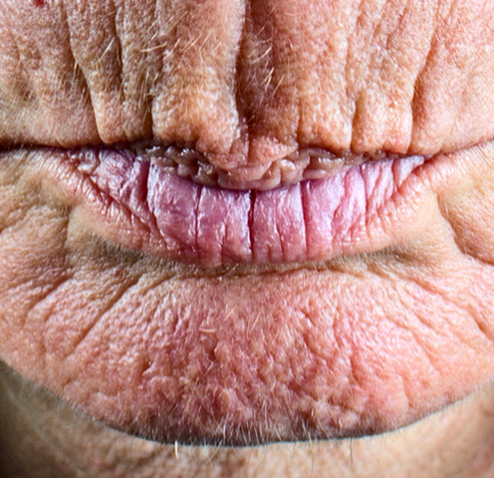
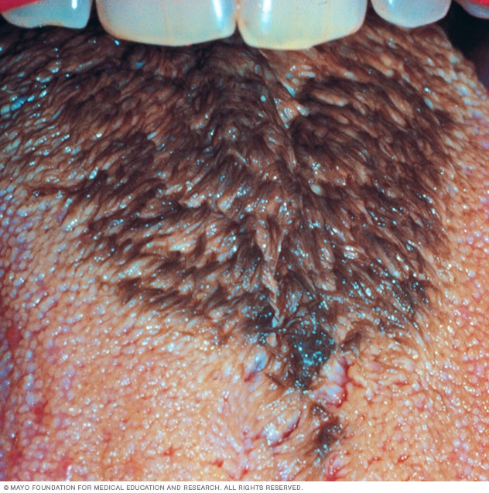
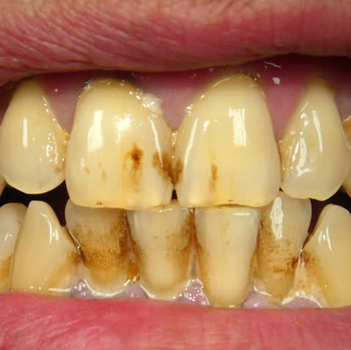
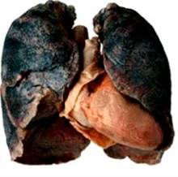
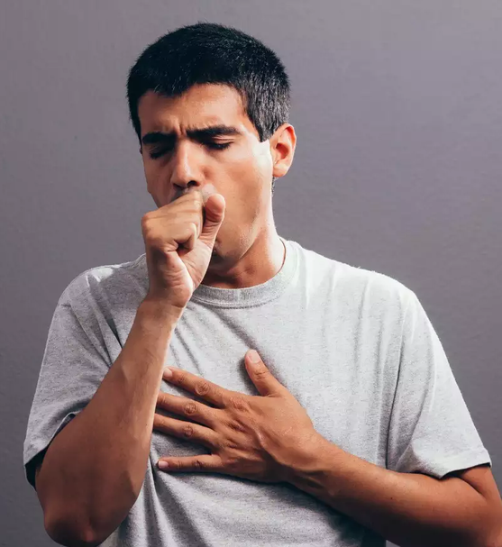
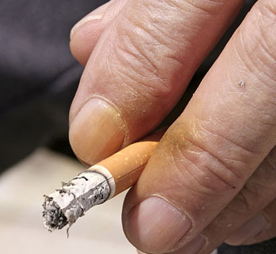
Side effects from smoking
Notes:
Images: wrinkled lips and mouth, hair-tongue, stained teeth, black lunds, coughing, stained fingers

Slide 6
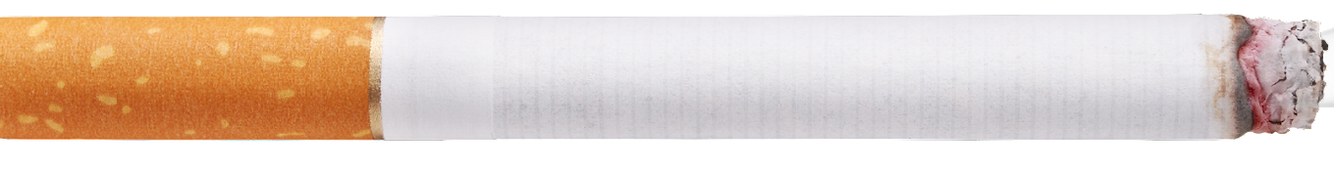



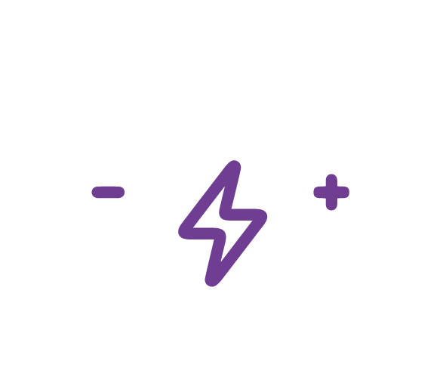










Toluene
Industrial solvent
Stain remover
Glue
Arsenic
Poison
Acetic acid
Disinfectant
Vinegar
Solvent
Cadmium
Metal coatings
Battery acid
Pigments
Paint
Ammonia
Toilet cleaner
Waxes
Polish
Butane
Lighter fluid
Aerosol sprays
Carbon monoxide
Nicotine
Insecticide
Tar
Methanol
Adhesives
Rocket fuel
Stearic acid
Candle wax
Soap
Methane
Acetone
Printing inks
Paint stripper

Slide 7
E-cigarettes
The use of e-cigarettes in under 18s has increased rapidly in the last 3 years, but still remains low at only 7.6% occasional or regular use.
Even including experimental 'ever use' put the rate at 22% of young people – up from 12.5% in 2021.
15.8%
of 11 to 17-year-olds
£££
The rise is mostly from increased use of disposable vapes marketed by companies wanting to make more profit from younger people. Fewer adults are smoking so companies need to find alternative ways to increase profits.

Slide 8
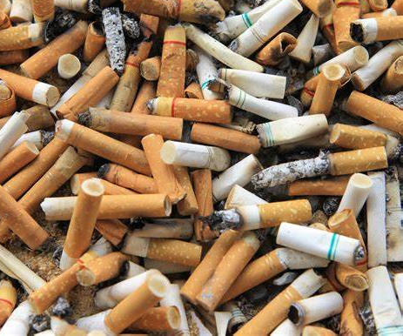
Cigarettes
The tobacco epidemic is one of the biggest public health threats the world has ever faced, killing more than 8 million people a year.
There are more than 4,000 chemicals in a cigarette.

Slide 9

Shisha
Tobacco is heated to produce smoke which bubbles through
a bowl of water and into a long hose-like pipe to be breathed in.
1 hour of shisha is the equivalent
of smoking 100 cigarettes.

Slide 10




E-cigarettes
E-cigarettes and vapes were designed as smoking cessation tools to help adult smokers quit smoking. They use liquid nicotine to help relieve cravings and withdrawal when quitting tobacco.
They are safer than smoking cigarettes but not risk-free. They still contain nicotine and other chemical additives, and we don't fully know the long-term effects of vaping yet.
Short-term effects can be coughing, sore throats and dizziness

Slide 11





Smoking and Covid-19
>2x
Research from St Guy’s and St Thomas’ hospitals and King’s College London (2020) has shown that smokers with a positive Covid-19 test were more than twice as likely as non-smokers with a positive test to be hospitalised.
likely to be hospitalised
1.8x
This aligns with research from North America which found that smokers with Covid-19 were 1.8 times more likely to die than those who do not smoke.
likely to die
41%
Research by ASH (2020) shows more than a million people have given up smoking since the Covid-19 pandemic hit. 41% of those who quit in the 4 months up to the date of the report said it was in direct response to coronavirus.
quit because of Covid-19

Slide 12


Burning money
The average pack of
cigarettes costs £12.50

Slide 13


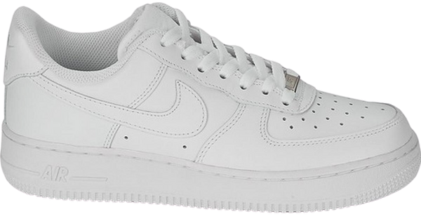
A week of saving:
A month of saving:
A year of saving:
Based on an average of 5.6 packets of cigarettes smoked each week.
Notes:
One week of saving is around £70
One month of savings is around £280
One year of saving is around £3000

Slide 14

Be a part of the Smokefree generation!
For more information or support visit
Smokefree Sheffield:
smokefreesheffield.org
Or
Sheffield Smokefree Service:
sheffield.yorkshiresmokefree.nhs.uk

