Slide 2
Smoking causes disease, poor health and early death.
Notes:
Ask the class what the health effects of smoking are.

Slide 3

Many adult smokers switch to nicotine vapes to help them quit smoking.
Notes:
See slides 5-8 of the Teachers’ Toolkit.

Slide 4

Most young people don’t
vape or smoke.
Notes:
Stats can be found on slide 3 and 10 of the Teachers’ Toolkit

Slide 5
Vaping is less harmful than smoking because you don’t inhale the toxic tar and carbon monoxide found in tobacco smoke.
Notes:
Ask if students know how many chemicals are in tobacco smoke. See slide 11 of the Teachers’ Toolkit.

Slide 6
But vapes are
not harmless.
Notes:
Can students explain why vapes may not be harmless?

Slide 7

Short-term effects of vaping can include coughing, headaches, dizziness and sore throats.
Notes:
See slide 12 of the Teachers’ Toolkit

Slide 8


And the long-term effects are, as yet, unknown.

Slide 9
Vapes and vaping products
that contain nicotine are
age-restricted.
Notes:
See slides 19 and 20 of the Teachers’ Toolkit

Slide 10
It’s against the law to sell them to anyone under 18.
It’s also illegal for adults to buy vapes for anyone under 18.

Slide 11

Anyone who knowingly sells vapes to under 18s is
driven by profit and doesn’t
care who they sell to.
Notes:
Ask the students what they could do or who they can tell if they know of anyone selling vapes to young people.

Slide 12



Vapes can have an impact on the environment.
Notes:
Ask the students what they think the environmental impact is of using vapes?

Slide 13
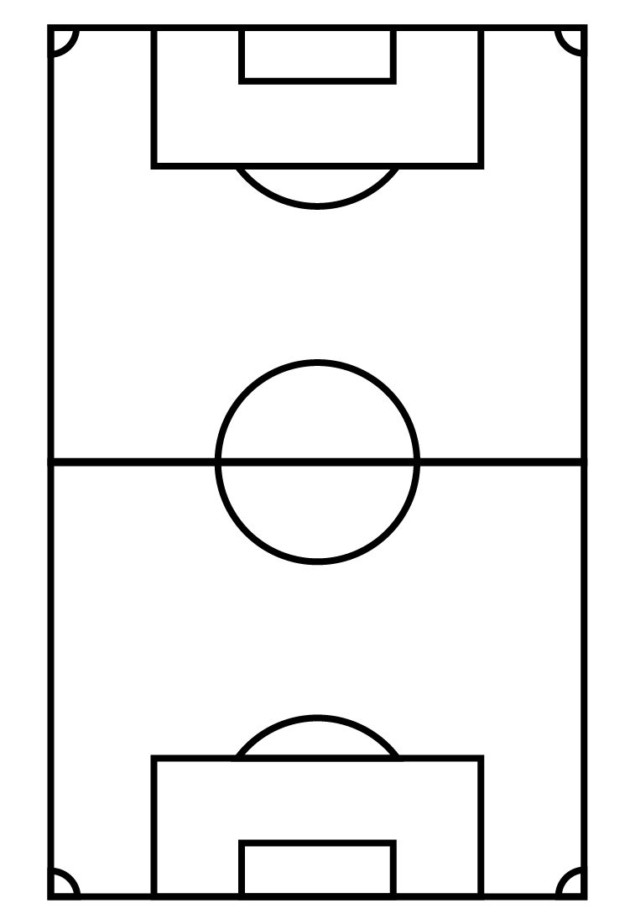
Approximately 1.3 million disposable vapes are thrown away every week in the UK: enough to cover 22 football pitches.
Notes:
Now that they are thinking about disposable vapes and the numbers involved, does this change what they think the environmental consequences are?

Slide 14
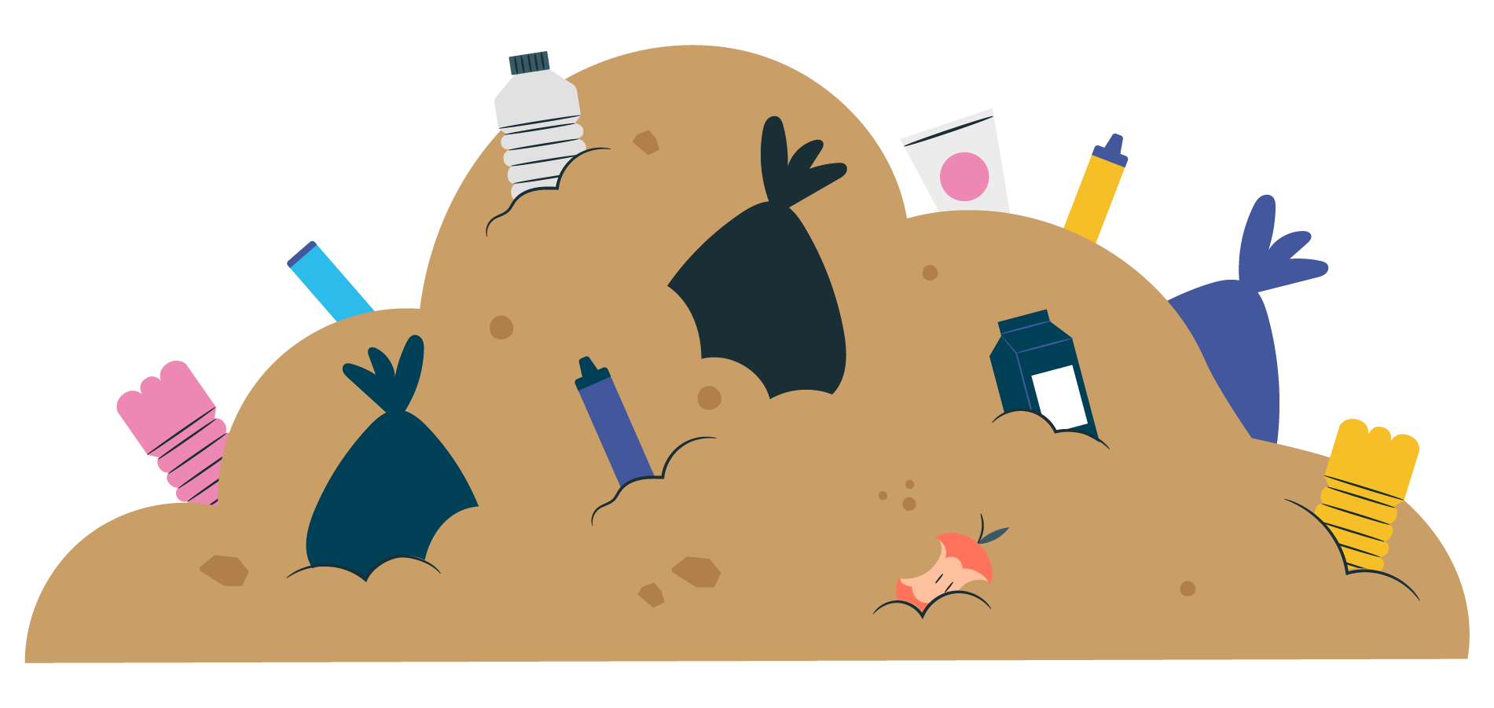
Single-use vapes contain batteries and
difficult to recycle plastics.
These break down in landfills causing dangerous chemicals to pollute the
soil and water.
Notes:
See slide 26 of the Teachers’ Toolkit

Slide 15
These chemicals can cause harm to humans, animals
and the environment.

Slide 16
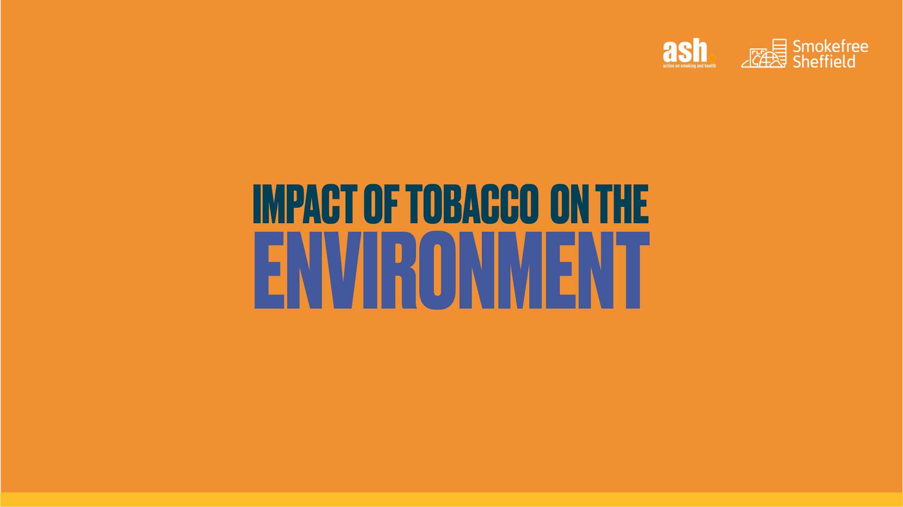

Slide 17

The tobacco supply chain is extremely environmentally harmful on a global scale. Environmental impact at all stages:
Cultivation/
farming
Curing
Primary
processing
Manufacturing
Distribution
Use/
disposal

Slide 18
These result in:
pollution
soil degradation
biodiversity losses
Deforestation
and
Death: Tobacco kills 8 million people a year

Slide 19
Around six trillion cigarettes are manufactured each year globally using 5.3 million hectares of land and 600 million trees.
Cigarettes are the most littered item on the planet with 4.5 trillion cigarette butts polluting our pavements, parks, soil, rivers, beaches and oceans
Notes:
See slide 28 of the Teachers’ Toolkit
More information:
Zafeiridou et al. 2018). https://doi.org/10.1021/acs.est.8b01533.
https://ash.org.uk/uploads/Tobacco-Environment.pdf

Slide 20
All of this produced 25 megatons of solid waste, 55 megatons of waste water, almost 84 megatons of CO₂ emissions to climate change – approximately 0.2% of the global total.

Slide 21
Remember, vapes are meant to help smokers
to quit for good.

Slide 22
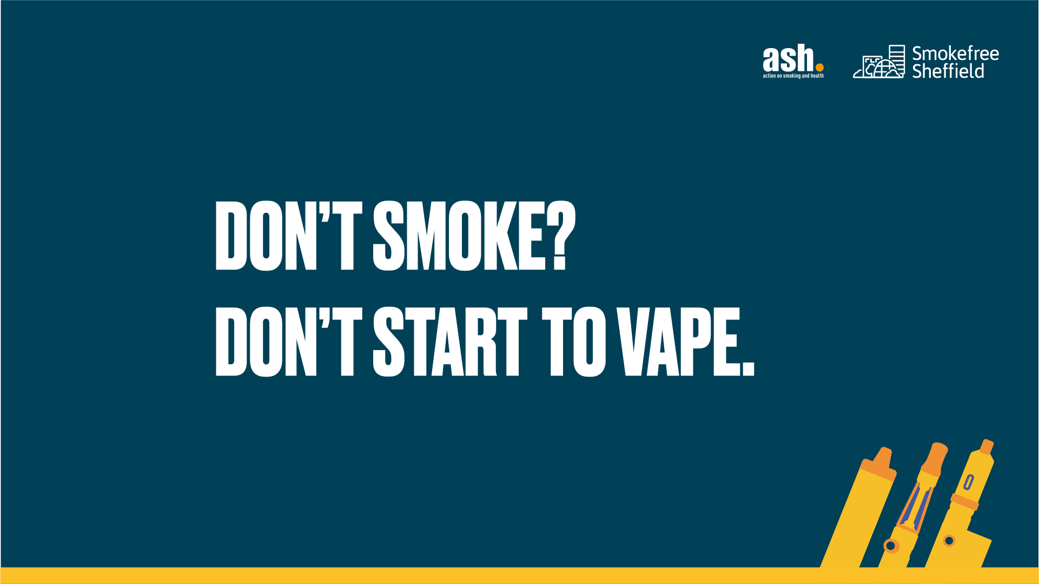

Slide 23
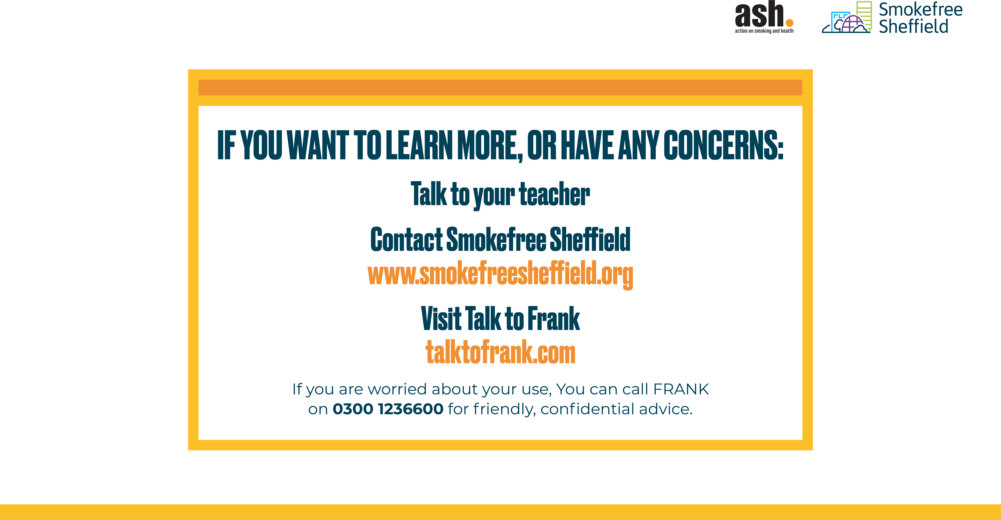
Notes:
See slides 31-33 of the Teachers’ Toolkit

